Slide 1

Micro Credit Defaulter Project
BY: SONALI WARKHADE

Slide 2
Objective:
We have a client who has a website where people write different reviews for technical products. Now they are adding a new feature to their website i.e. The reviewer will have to add stars(rating) as well with the review. The rating is out 5 stars and it only has 5 options available 1 star, 2 stars, 3 stars, 4 stars, 5 stars. Now they want to predict ratings for the reviews which were written in the past and they don’t have a rating. So, we have to build an application which can predict the rating by seeing the review.

Slide 3
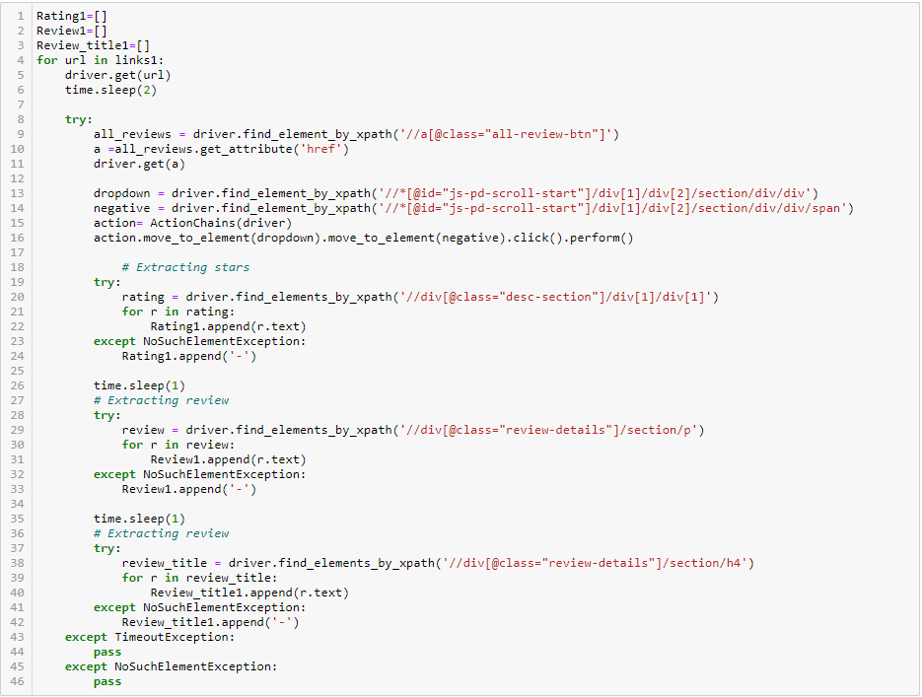
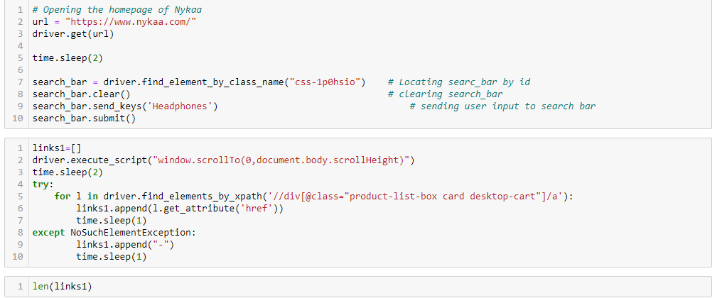
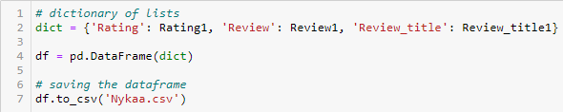
With the help of Selenium I have scrapped data from different websites like, Snapdeal, Flipkart and Amazon and used Pandas library to save the data in excel file. Just taking a glace on basic code for scrapping from different websites.
Saving the scrapped data into a csv file:

Slide 4
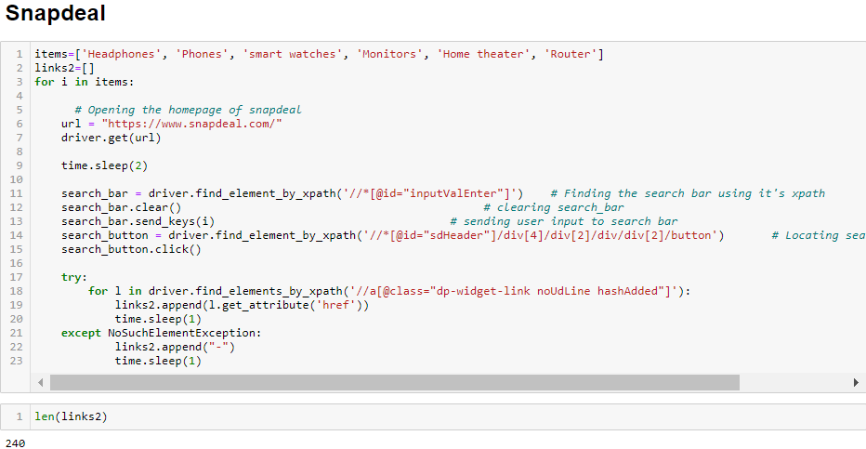
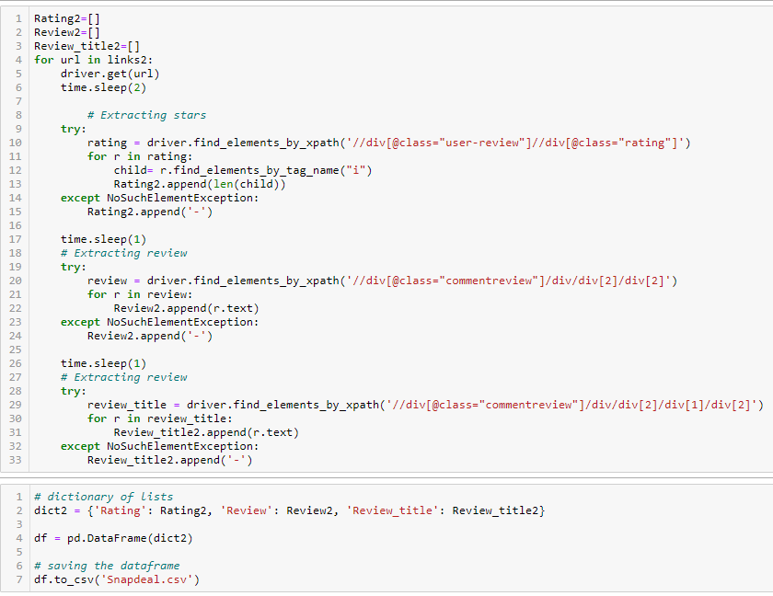

Slide 5
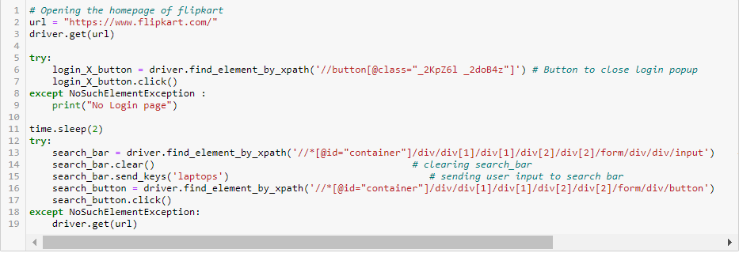
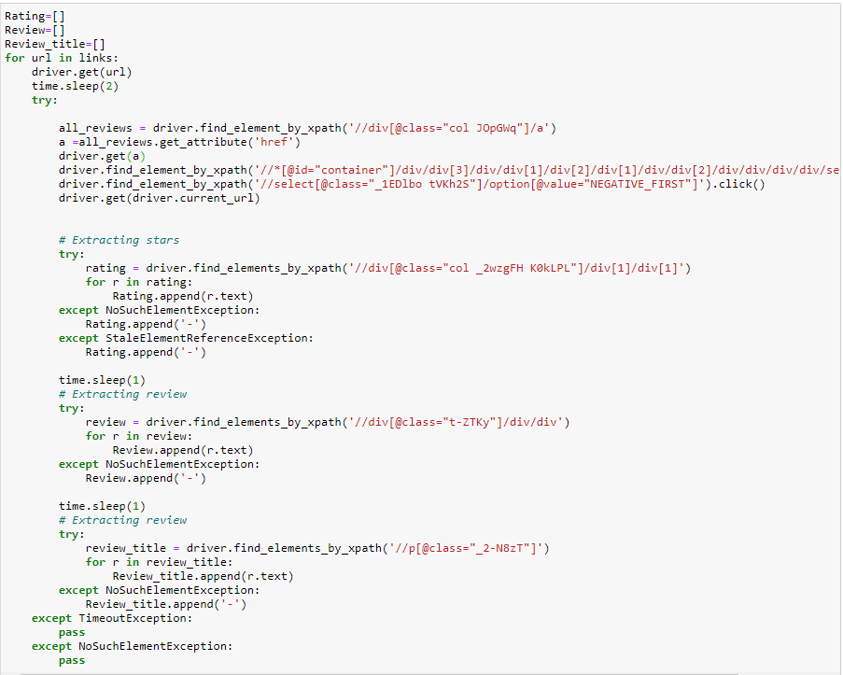
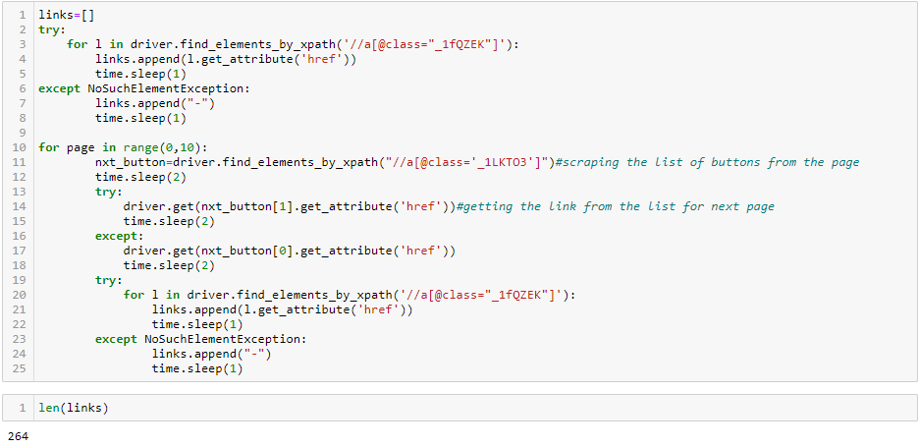

Slide 6
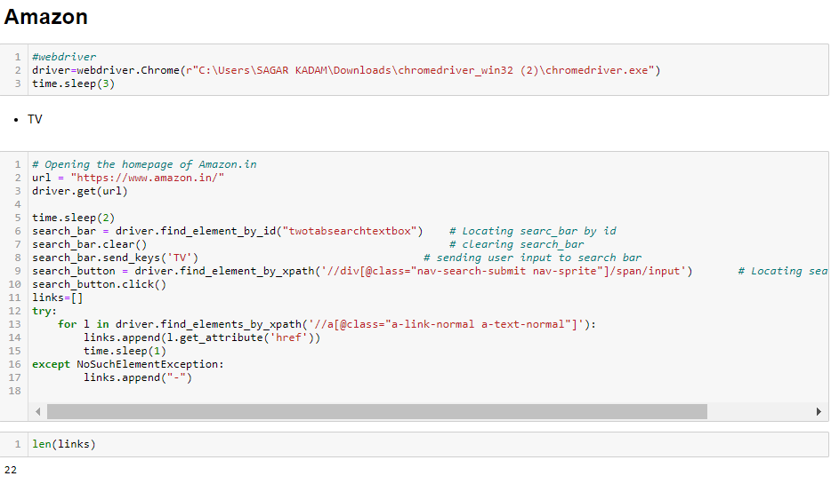
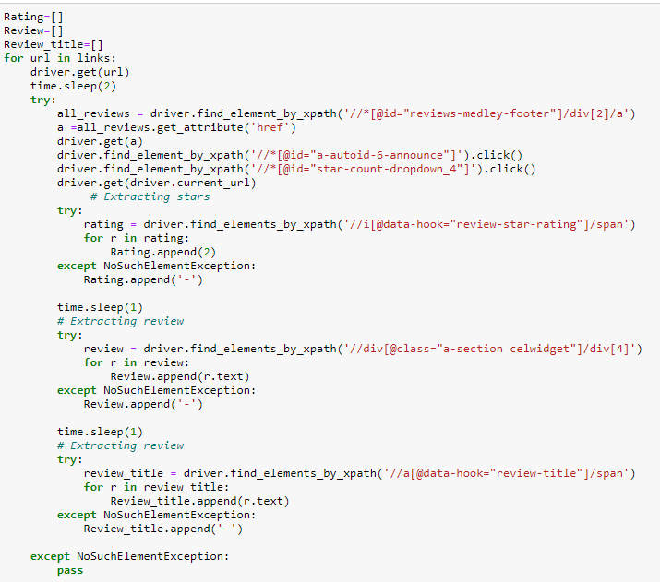
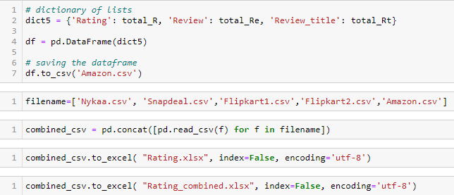

Slide 7
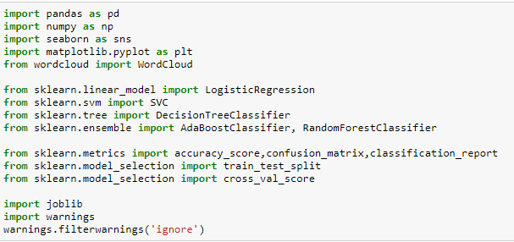
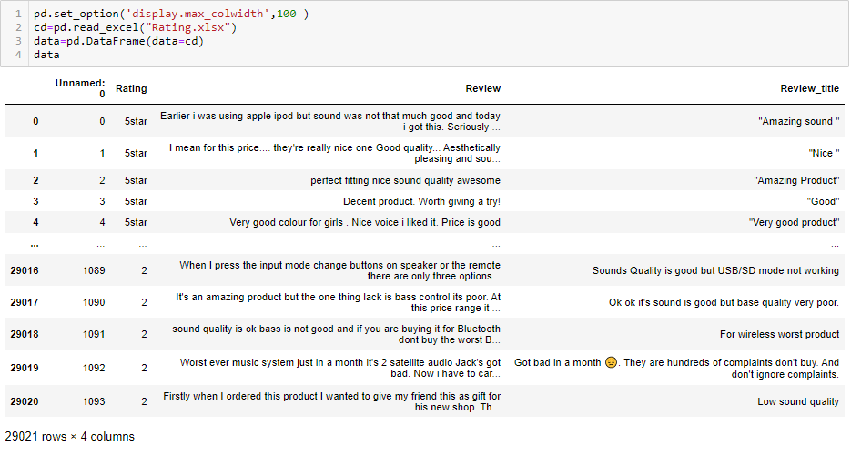
Importing required libraries and databases:

Slide 8
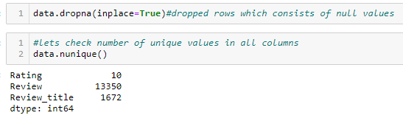
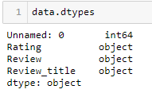


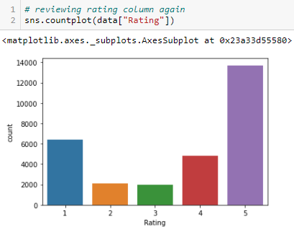
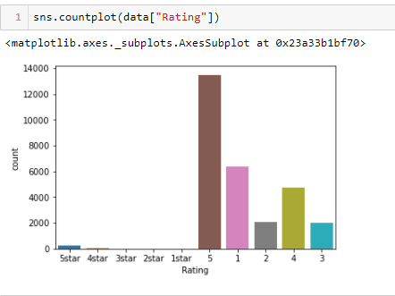
Database consists of 4 columns and 29021 rows
Our rating should only consist of 5 unique values i.e 1, 2, 3, 4, 5. let's have a look at rating column data with the help of countplot.

Slide 9
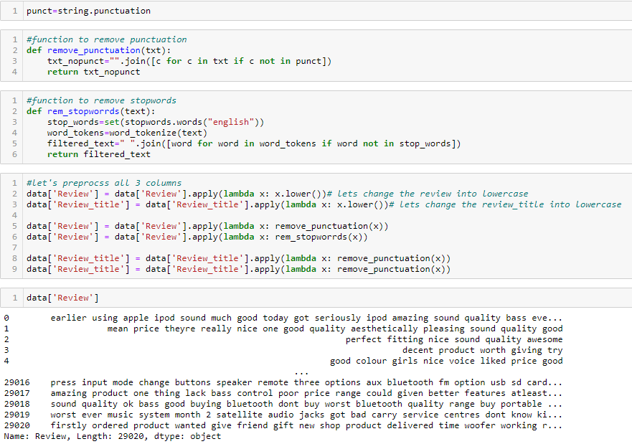
Let's do preprocessing of data with the help of NLP:

Slide 10
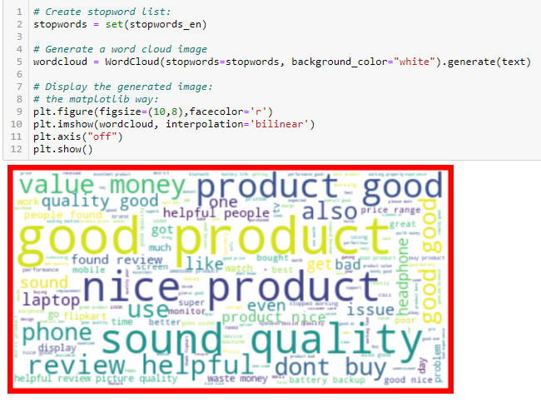
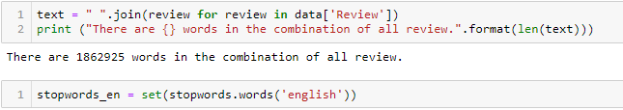
Wordcloud
Let's join all words in review column in a variable text:
Above cloud gives us the most common words in entire reviews in bigfont size, word with smaller size is less used or less common.

Slide 11
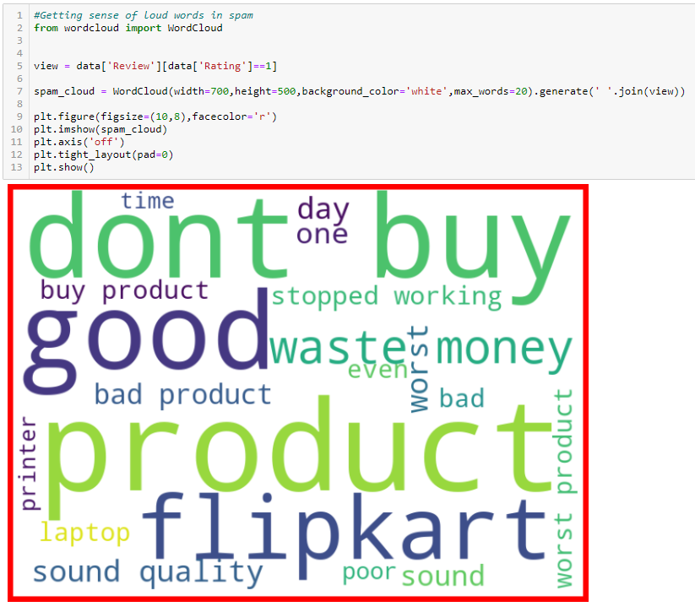
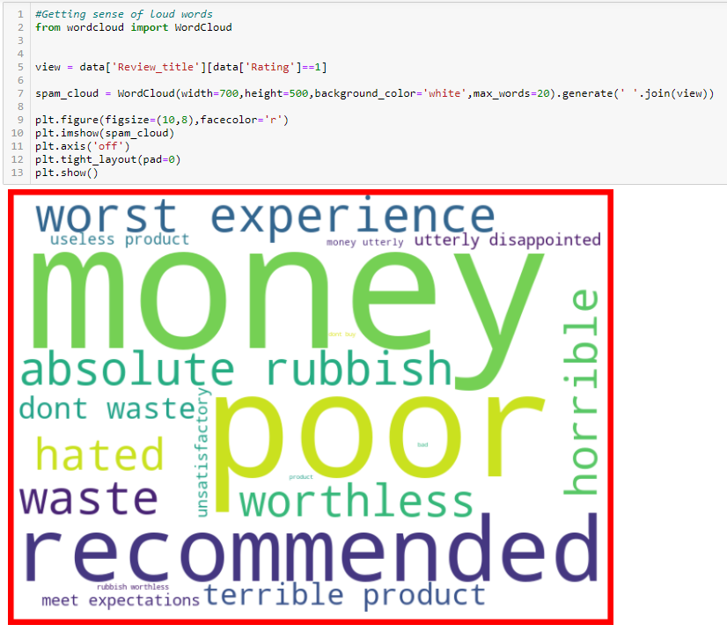

Slide 12
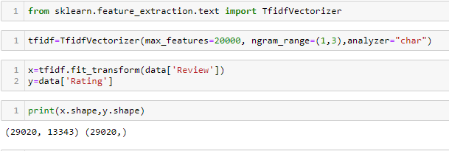
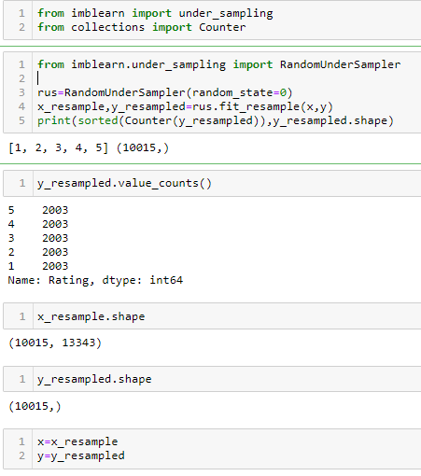
Let's use TFidf method to transform data into vectors:
We will use under sampling method to balance the target column value counts:

Slide 13
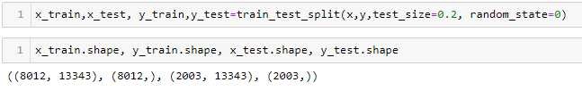
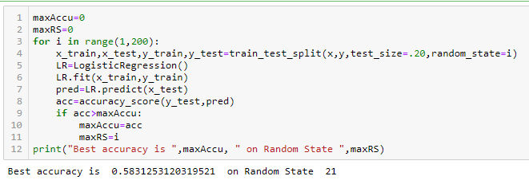
Model/s Development and Evaluation
Let's find best random state:

Slide 14
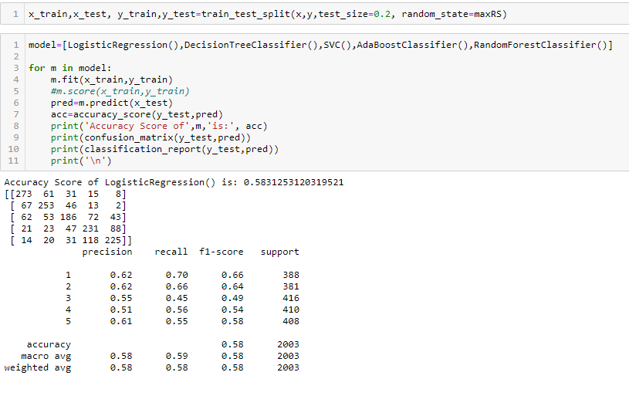
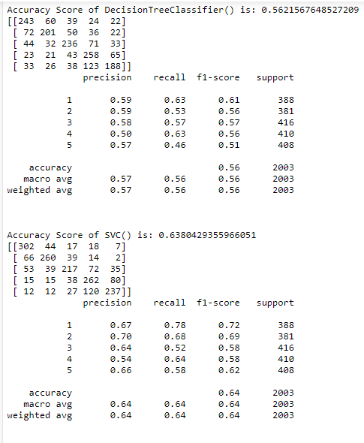

Slide 15
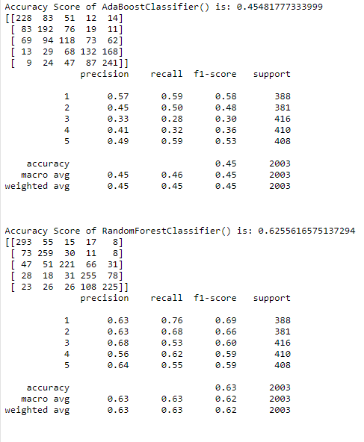

Slide 16
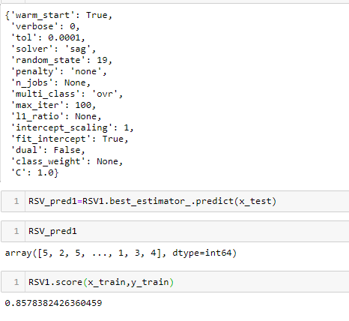
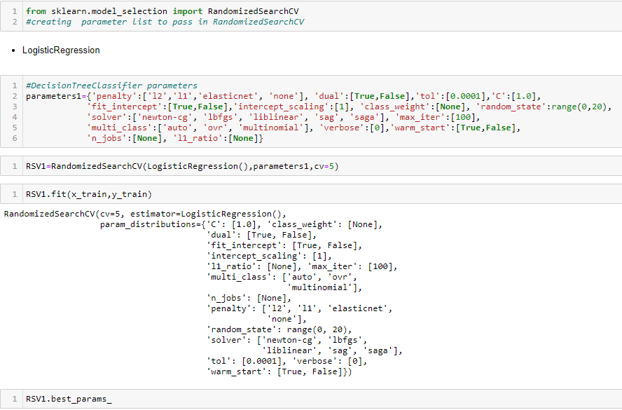
Hyper parameter tunning:
Hyper parameter tunning with LogisticRegression gives us 85.78 % accuracy.

Slide 17
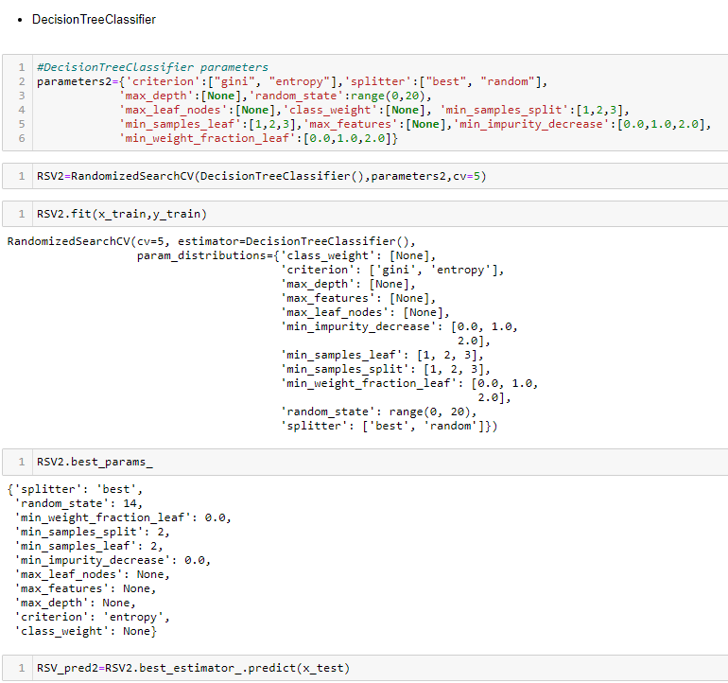
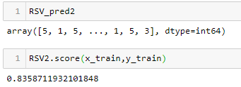
Hyper parameter tunning with DecisionTreeClassifier gives us 83.59 % accuracy.

Slide 18
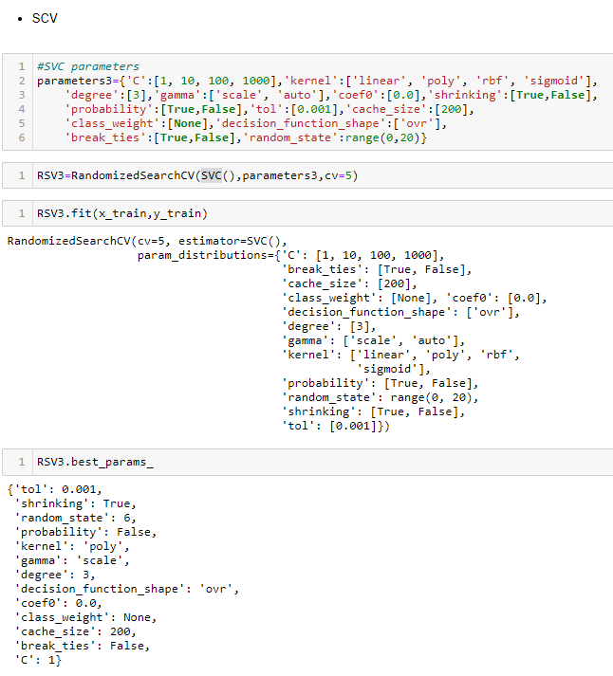
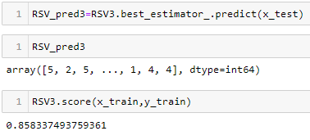
Hyper parameter tunning with SVC gives us 85.83 % accuracy.

Slide 19
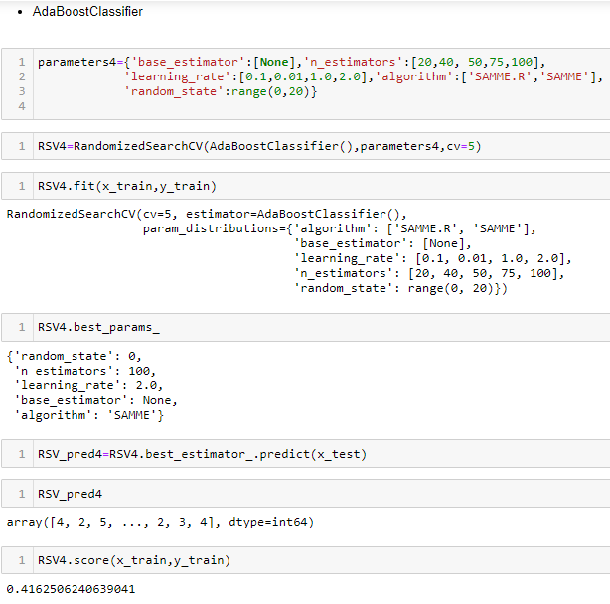
Hyper parameter tunning with adaboost classifier gives us 41.63 % accuracy.

Slide 20
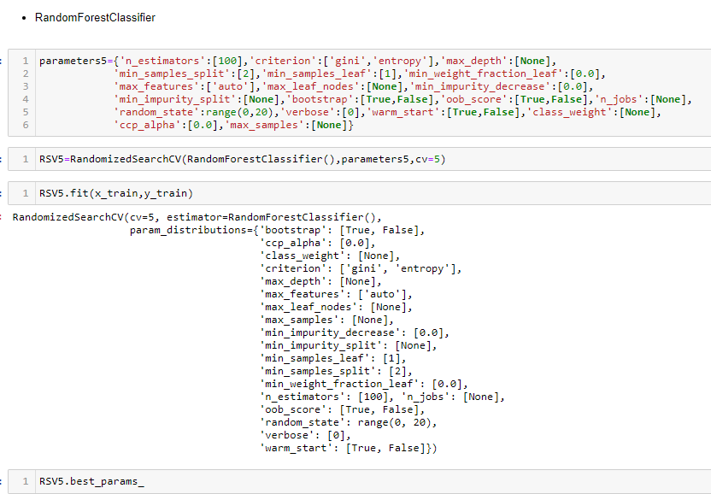
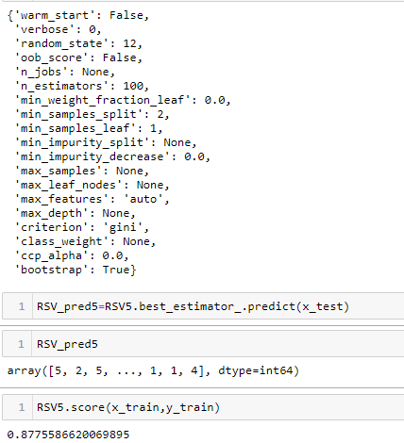
Hyper parameter tunning with RandomForestClassifier gives us 87.76% accuracy.
Considering RandomForestClassifier with RandomizedSearchCV as final model for saving model.

Slide 21
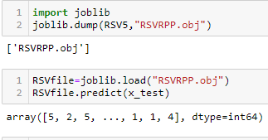
Saving model:

Slide 22
Thank You

